Slide 1

Reinforcement Learning in Gymnasium
By: Osher Jacob
25/02/2025
From Random to Deep Q-Networks
Exploring RL techniques (Q-learning and DQN) for training agents in Gymnasium environments.

Slide 2
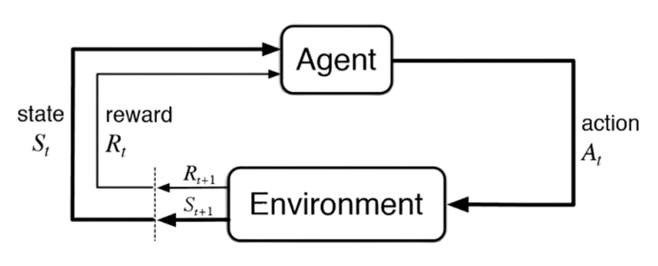
Introduction to Reinforcement Learning
What is Reinforcement Learning (RL)?
Agents learn through interaction with an environment.
Goal: Maximize cumulative reward.
Key Components:
Agent, Environment, State, Action, Reward.
Why RL is Powerful:
Enables learning complex decision-making.
Applications in robotics, gaming, and more.

Slide 3
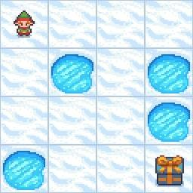
Random Agent (Baseline)
Observation Space:
[Player position = current_row * ncols + current_col]
Action Space:
[Move left, Move down, Move right, Move up]

Slide 4
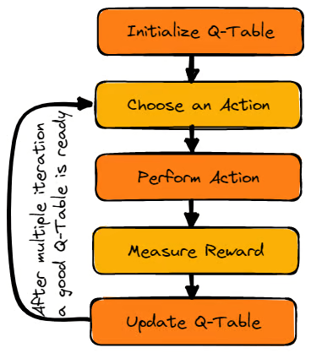
Q-Learning
What is Q-learning?
Model-free RL algorithm.
Learns the optimal action-value function (Q-values).
Key Concepts:
Q-table: Stores Q-values for state-action pairs.
Update rule: Iteratively updates Q-values based on rewards.

Slide 5
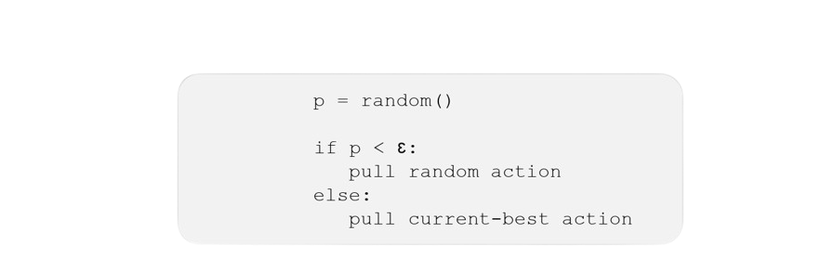
Exploration vs Exploitation
Epsilon-Greedy Policy:
Balances exploration and exploitation
Starting the training with random actions (epsilon=1.0)
At later episodes the agent choose the best known action with a high probability, and a random action with a small probability (epsilon ~ 0)

Slide 6
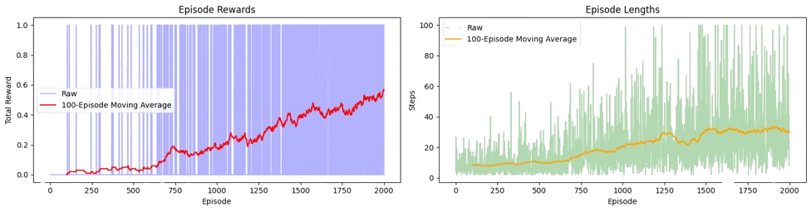
Q-Learning Metrics

Slide 7

Q-Learning Results

Slide 8
Limitations of Q-Learning
Scalability Issues:
Q-table becomes large for complex environments.
Difficult to handle continuous state spaces.
Memory Requirements:
Large state spaces require large amounts of memory.
Generalization:
Struggles to generalize to unseen states.

Slide 9
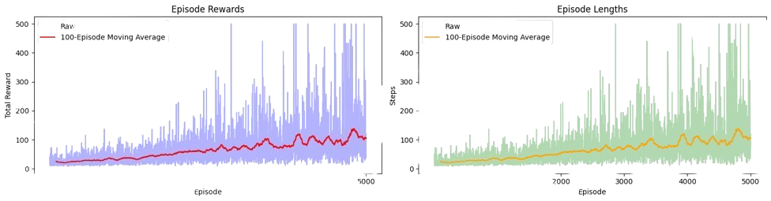
Cart Pole Challenge
- State space is continuous
- Q-learning can only handle discrete states because it updates a table of states
- Observations were discretesized by rounding decimals

Slide 10
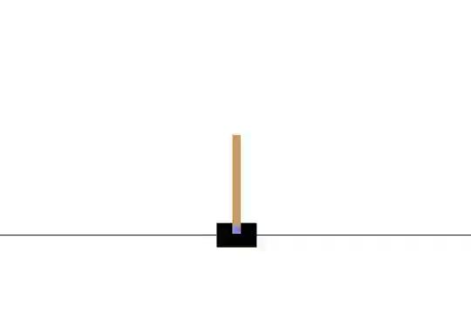
Q-Learning Results

Slide 11
Deep Q-Network
What is DQN?
Combines Q-learning with deep neural networks.
Approximates Q-values using a neural network.
Key Concepts:
Deep neural network as a function approximator.
Experience replay: Stores and samples past experiences.
Target network: Stabilizes training.
Advantages:
Handles high-dimensional continuous state spaces.
Improves generalization.

Slide 12
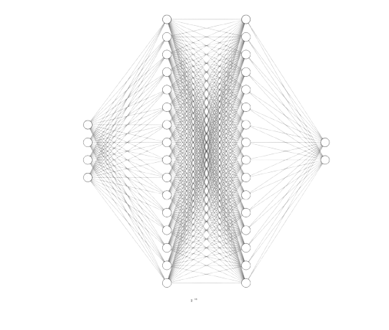
Architecture
State Space: [Cart Position, Cart Velocity, Pole Angle, Pole Angular Velocity]
Action Space: [Move Left, Move Right]
Input (4)
Output (2)
Hidden (16)
Hidden (16)

Slide 13
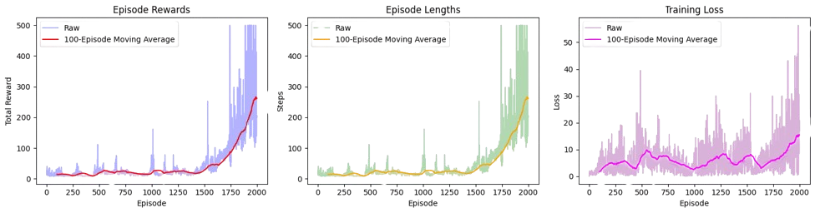
DQN Metrics

Slide 14
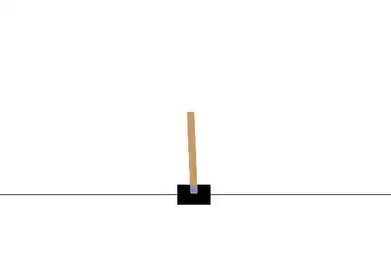
DQN Results

Slide 15
Conclusions
Summary of Findings:
Reinforcement learning effectively trains agents in Gymnasium.
DQN outperforms Q-learning in complex environments.
Challenges:
Hardware & training times
Following the training progress
Balancing exploration and exploitation
Future work:
Apply RL to more complex environments with visual input using CNNs
Investigating other RL algorithms

Slide 16
Thank You!

